Slide 1
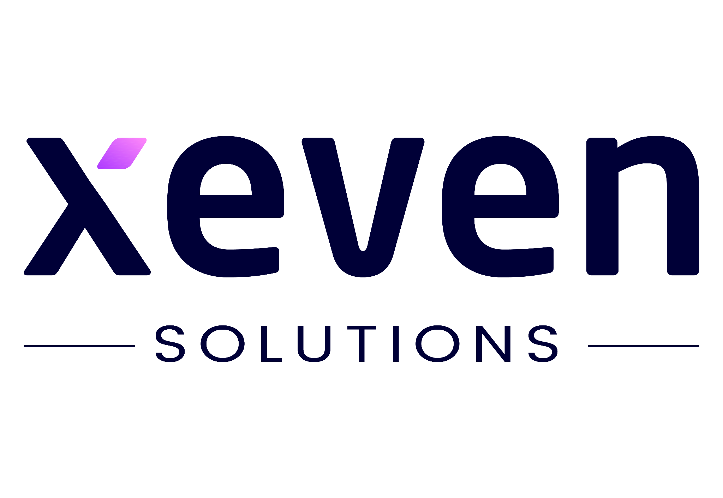

Hope to Skills Artificial Neural Networks (ANN)
Lecture# 25
Irfan Malik, Dr. Sheraz Naseer, Dr. Shazia Saqib, Haris

Slide 2
Agenda
Problem with linear Models
Neural Networks
Why Neural Networks
Hyper parameters
Learning rate
Epochs
Regularization
Activation functions

Slide 3
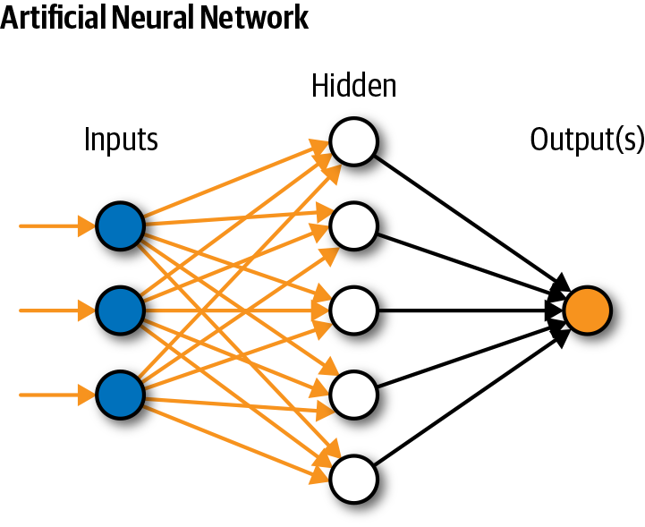
Simple Neural Network

Slide 4
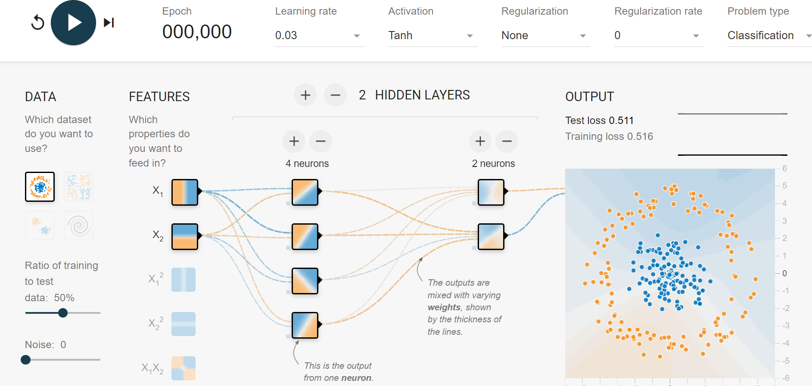
Hyper-parameters

Slide 5
Learning Rate
A hyperparameter that controls the step size during gradient descent optimization. It determines how quickly the model adjusts its parameters in the direction that reduces the loss.
A higher learning rate might lead to faster convergence but risks overshooting, while a lower rate might slow down convergence.

Slide 6
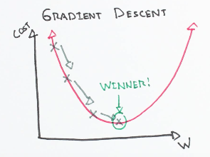
Gradient Descent

Slide 8
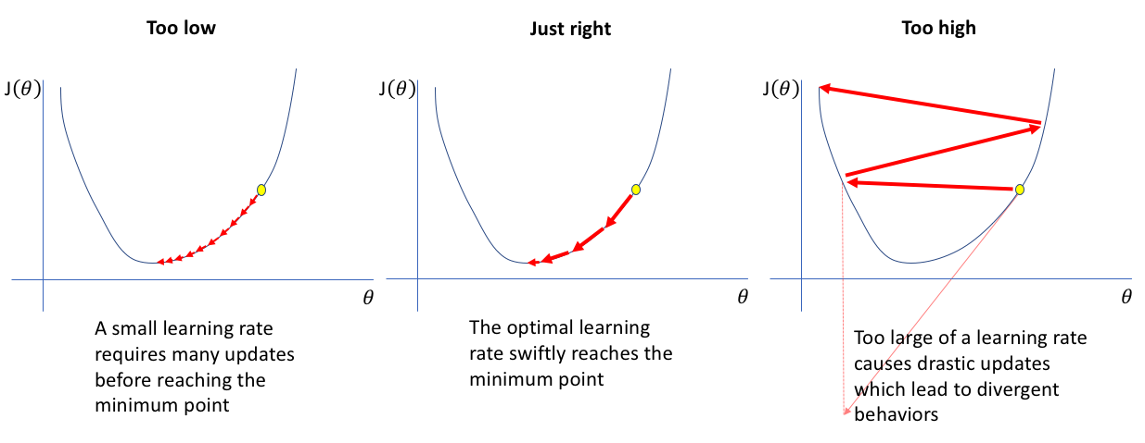
Learning Rate
A higher learning rate might lead to faster convergence but risks overshooting, while a lower rate might slow down convergence.

Slide 9
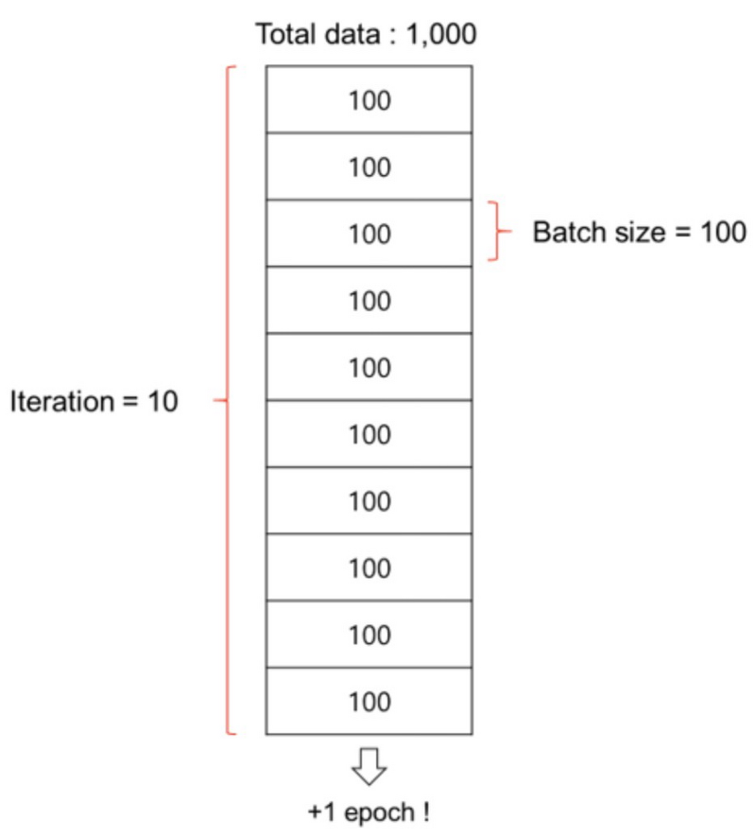
Batch Size
Batch is a subset of the training dataset used in each iteration of the training process.
Instead of processing the entire dataset
at once, we divide it into smaller batches.

Slide 10
Batch Size
Batch size is the number of training examples in each batch.
It's a hyperparameter that can be adjusted based on hardware limitations and dataset characteristics.
Larger batch sizes may speed up training but require more memory.

Slide 11
Number of Epochs
The number of times the entire training dataset is seen by the model during training.
Too few epochs might result in underfitting, while too many epochs can lead to overfitting(Might be controlled with Early Stopping).

Slide 12
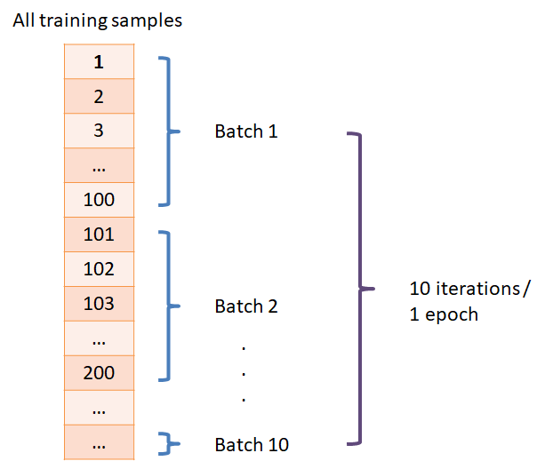
Number of Epochs

Slide 13
Activation Functions (Neuron)
It determine the functions applied to the outputs of each neuron to introduce non-linearity.
Common activation functions include
ReLU (Rectified Linear Unit) output the input directly if it is positive, otherwise, it will output zero(f(x) = max(0, x)),
Softmax converts a vector of numbers into a vector of probabilities, all probabilities sum to the value 1.0, The input values can be positive, negative, zero, or greater than one, but the softmax transforms them into values between 0 and 1, so that they can be interpreted as probabilities.

Slide 14
The Building Blocks of ANN
Neurons and layers are fundamental components of ANNs.
Neurons in ANNs process information similarly to brain neurons but digitally:
Receive inputs
Apply weights to inputs
Sum the inputs
Pass the result through an activation function
Layers of interconnected neurons each have specific roles:
Input layer: Receives raw data
Hidden layers: Perform complex computations
Output layer: Provides the final result or prediction

Slide 15
How ANN Learns
Training ANNs involves using labeled datasets to improve predictive accuracy.
ANNs automatically extract features through their interconnected layers, unlike traditional algorithms.
Inspired by the brain's neural network, ANNs self-learn and adapt without explicit programming.
ANNs handle complex tasks like image recognition, natural language processing, and autonomous driving.

Slide 16
Summary
- Advantages
- Can handle complex data
- Non-linear modeling capabilities
- Adaptability and learning capabilities
- Robustness to noisy or incomplete data
- Feature extraction capabilities
- Domain agnostic, applicable to various business areas
- Parallel processing for efficient computation
- Can handle high-dimensional data
- Can uncover hidden patterns and insights
-Disadvantages
- Requires large amounts of labeled training data
- Black box nature can hinder interpretability
- Computationally intensive and resource-consuming
- Lack of transparency in decision-making
- Potential overfitting without proper regularization
- Complexity and difficulty in model tuning
- Difficulty in explaining results to stakeholders
- Sensitivity to input data quality and preprocessing
- Ethical considerations in sensitive decision-making

Slide 17
What is TensorFlow?
TensorFlow is an open-source machine learning framework developed by Google.
It enables building, training, and deploying machine learning models.
Primarily used for deep learning tasks, it's versatile for various other types of machine learning.
Tensorflow

